Slide 1

Industry Project Presentation
on
“Privilege Escalation In Linux”
By
Group ID: 2026G198
Team Members Name & Enrollment No:
Prajapati Pratham(22162171023)
Patel Nachiket(22162171019)
Under The guidance of
Prof. Umesh Lakhtariya /Mr. Harsh Kiratsata
Institute Of Computer Technology, Ganpat University
Date:- 21th February 2026

Slide 2
Index Of Content
Abstract
Objectives
Scope of the Project
Workflow of Project
System Architecture
Technology Stack
Key Modules
Advantages
Limitations
Conclusion

Slide 3
Abstract
Linux Privilege Escalation refers to the process of gaining elevated access rights on a Linux system by exploiting misconfigurations, weak permissions, or vulnerable system components. This project presents a red team simulation conducted in a controlled Ubuntu environment to identify and analyze access control weaknesses.
The system integrates automated shell scripts, Telegram bot-based remote command execution, and a centralized web-based file repository to simulate real-world privilege escalation scenarios. Advanced automation using curl and wget enhances remote file handling and execution capabilities.
The project demonstrates how improper privilege management and misconfigured sudo permissions can be exploited, while also highlighting the importance of secure system configuration and monitoring mechanisms.

Slide 4
Objectives
To simulate Linux privilege escalation in a controlled lab environment in order to understand how misconfigurations, weak permissions, and improper sudo settings can lead to unauthorized privilege elevation.
To identify and analyze access control weaknesses such as improper file permissions, insecure sudo configurations, and flawed role-based restrictions that may expose the system to security risks.
To develop automated privilege escalation scripts that replicate real-world exploitation techniques while maintaining structured execution, error handling, and controlled testing procedures.
To integrate a Telegram bot for remote command execution, enabling centralized and controlled interaction with the system for monitoring, testing, and automation purposes.
To build a secure file repository system that supports file upload, download, and deletion operations with proper user isolation and admin-level access control mechanisms.
To create an All-in-One automation framework that integrates privilege escalation logic, file handling, and command execution into a modular and maintainable architecture.

Slide 5
Scope Of The Project
Our idea will Help in:
Designed for educational and research purposes, the project aims to provide practical exposure to Linux privilege escalation concepts while maintaining ethical standards and academic integrity.
Operates within a controlled Ubuntu-based laboratory environment, ensuring that all simulations and testing activities are performed safely without impacting external or production systems.
Focused on Red Team simulation techniques, the project replicates potential attack scenarios to analyze system misconfigurations and evaluate access control weaknesses.
Does not target real-world or live systems, and all experiments are conducted strictly within isolated virtual machines to maintain legal and ethical compliance.
Can be extended for vulnerability assessment and cybersecurity training, serving as a foundational framework for advanced security testing, blue team analysis, and defensive strategy development.

Slide 6
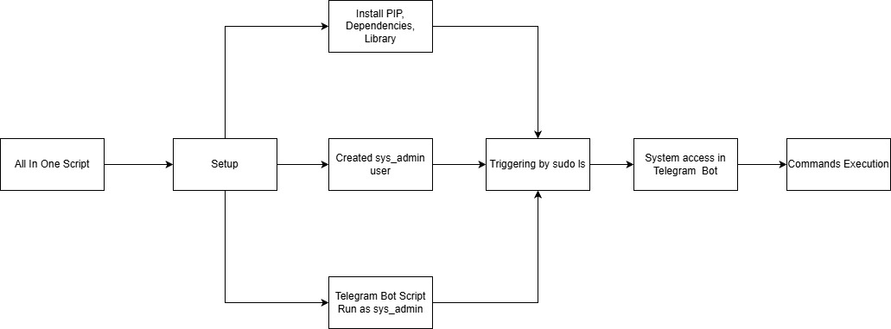
Workflow Of Project

Slide 7
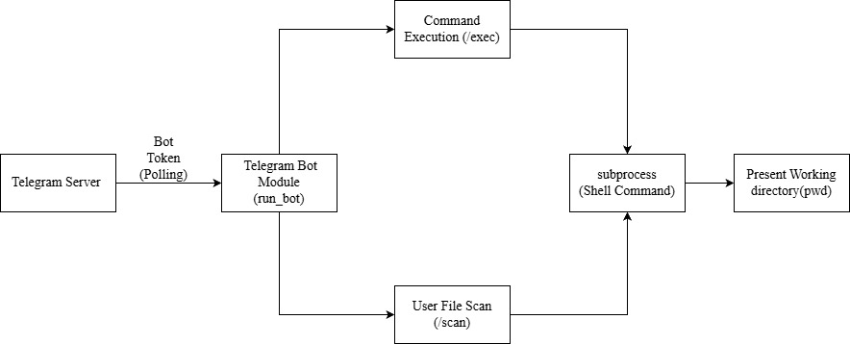
System Architecture

Slide 8
Technology Stack
Backend
Python
Shell Scripting
Node.js
Express.js
Platform
Ubuntu Linux
Communication
Telegram Bot API
Tools
curl
wget
sudo

Slide 9
Module Description
Privilege Escalation Module
Performs sudo manipulation testing to evaluate how misconfigured sudo permissions can be exploited to gain elevated privileges in a controlled Linux environment.
Implements permission validation mechanisms to analyze file, user, and group-level access controls and identify potential weaknesses in privilege management.
Executes controlled payloads to simulate real-world escalation scenarios while maintaining structured logging and execution monitoring for analysis.
Telegram Control Module
Enables remote command execution by integrating a Telegram bot with backend scripts, allowing centralized control over system-level operations.
Implements structured output formatting to ensure command responses are readable, organized, and properly displayed within the Telegram interface.
Applies secure access restrictions using authentication checks and user validation to prevent unauthorized command execution.

Slide 10
Module Description
File Repository Module
Provides a secure file upload feature that allows users to store files on the server with validation checks and integrity verification.
Implements controlled delete functionality with safeguards to prevent unauthorized or accidental file removal.
Enforces admin-only authorization for sensitive operations, ensuring role-based access control within the application.
Maintains user directory isolation by creating separate folders for each user to prevent cross-access and ensure proper data separation.
Download Automation Module
Supports curl-based file transfer mechanisms to enable command-line driven file uploads and downloads through automated execution workflows.
Integrates wget-based retrieval functionality for reliable remote file fetching and compatibility across different Linux environments.
Implements error handling and optimization techniques to improve execution stability, minimize failures, and enhance performance efficiency.

Slide 11
Module Description
All-in-One Script
Provides a unified architecture that integrates privilege escalation logic, file handling, download automation, and bot communication into a single execution framework.
Ensures modular integration, allowing independent components to function cohesively while maintaining maintainability and scalability.
Performs cross-platform and multi-system testing to validate compatibility, execution reliability, and consistent behavior across Ubuntu-based environments.

Slide 12
Advantages
Provides a real-world red team simulation experience, allowing practical understanding of how privilege escalation techniques are performed and analyzed within a controlled cybersecurity testing environment.
Enables automated exploitation testing, reducing manual intervention while improving consistency, repeatability, and efficiency in assessing privilege-related vulnerabilities.
Supports remote command execution through Telegram integration, offering centralized control and monitoring of system-level operations in a secure and structured manner.
Implements a modular architecture, where individual components such as escalation scripts, file repository, and bot integration are developed independently for better scalability and maintainability.
Ensures multi-system compatibility, allowing the developed scripts and automation framework to function reliably across different Ubuntu-based environments.
Follows a structured security assessment approach, systematically identifying, testing, and validating access control weaknesses to enhance overall system security awareness.

Slide 13
Limitations
Operates only within a controlled laboratory environment, meaning the simulation results may not fully represent the complexity and variability of real-world production systems.
Requires intentional system misconfigurations for testing, as privilege escalation scenarios depend on predefined weaknesses that may not always exist in properly secured environments.
Not intended for offensive real-world use, and the framework is strictly designed for academic research, security awareness, and controlled red team simulation purposes.
Subject to ethical and legal boundaries, as all testing must be performed with proper authorization and within isolated systems to avoid misuse or unauthorized access.

Slide 14
Conclusions
This project successfully demonstrates a structured red team simulation of Linux privilege escalation within a controlled Ubuntu environment. By integrating automation scripts, Telegram-based remote command execution, and a centralized web-based file repository, the system effectively replicates real-world access control weaknesses.
The development of modular escalation scripts, advanced download automation, and an all-in-one execution framework highlights how misconfigured sudo permissions and improper file access controls can compromise system security.
Overall, the project provides valuable insights into Linux privilege management, reinforces the importance of secure configuration practices, and serves as an educational model for understanding and mitigating privilege escalation vulnerabilities.

Slide 15
Thank You

